Slide 1
Typescript – setting up environemnt
In visual studio code
1. Installing typescript – (if you don’t have it)
npm install -g typescript
2. Gledane na versiata na typescript
tsc -v
3. Compile your ts code into js ->tuj she ni suzdade (compilira) ts file-a v js file
tsc nameOfTsDoc.ts
4. Create typescript config file ->shte ni suzdade tsconfig.json
tsc --init
//v toia file toy uncommentna
- "noUnusedLocals": true, //tva ti kazva suzdade li var i posle nikoga ne ia polzva
- "outDir": "./js" (tuj e dir det js files shte gi generira
5. vednuj kat imame config file mojen veche samo da si runnvame tsc (vmesto tsc + imeto na filea)
Tsc
Notes:
Course Pluralsight:
Lector: Simon Allardice ->mnogo gotin lector!
https://app.pluralsight.com/library/courses/typescript-big-picture/table-of-contents

Slide 2
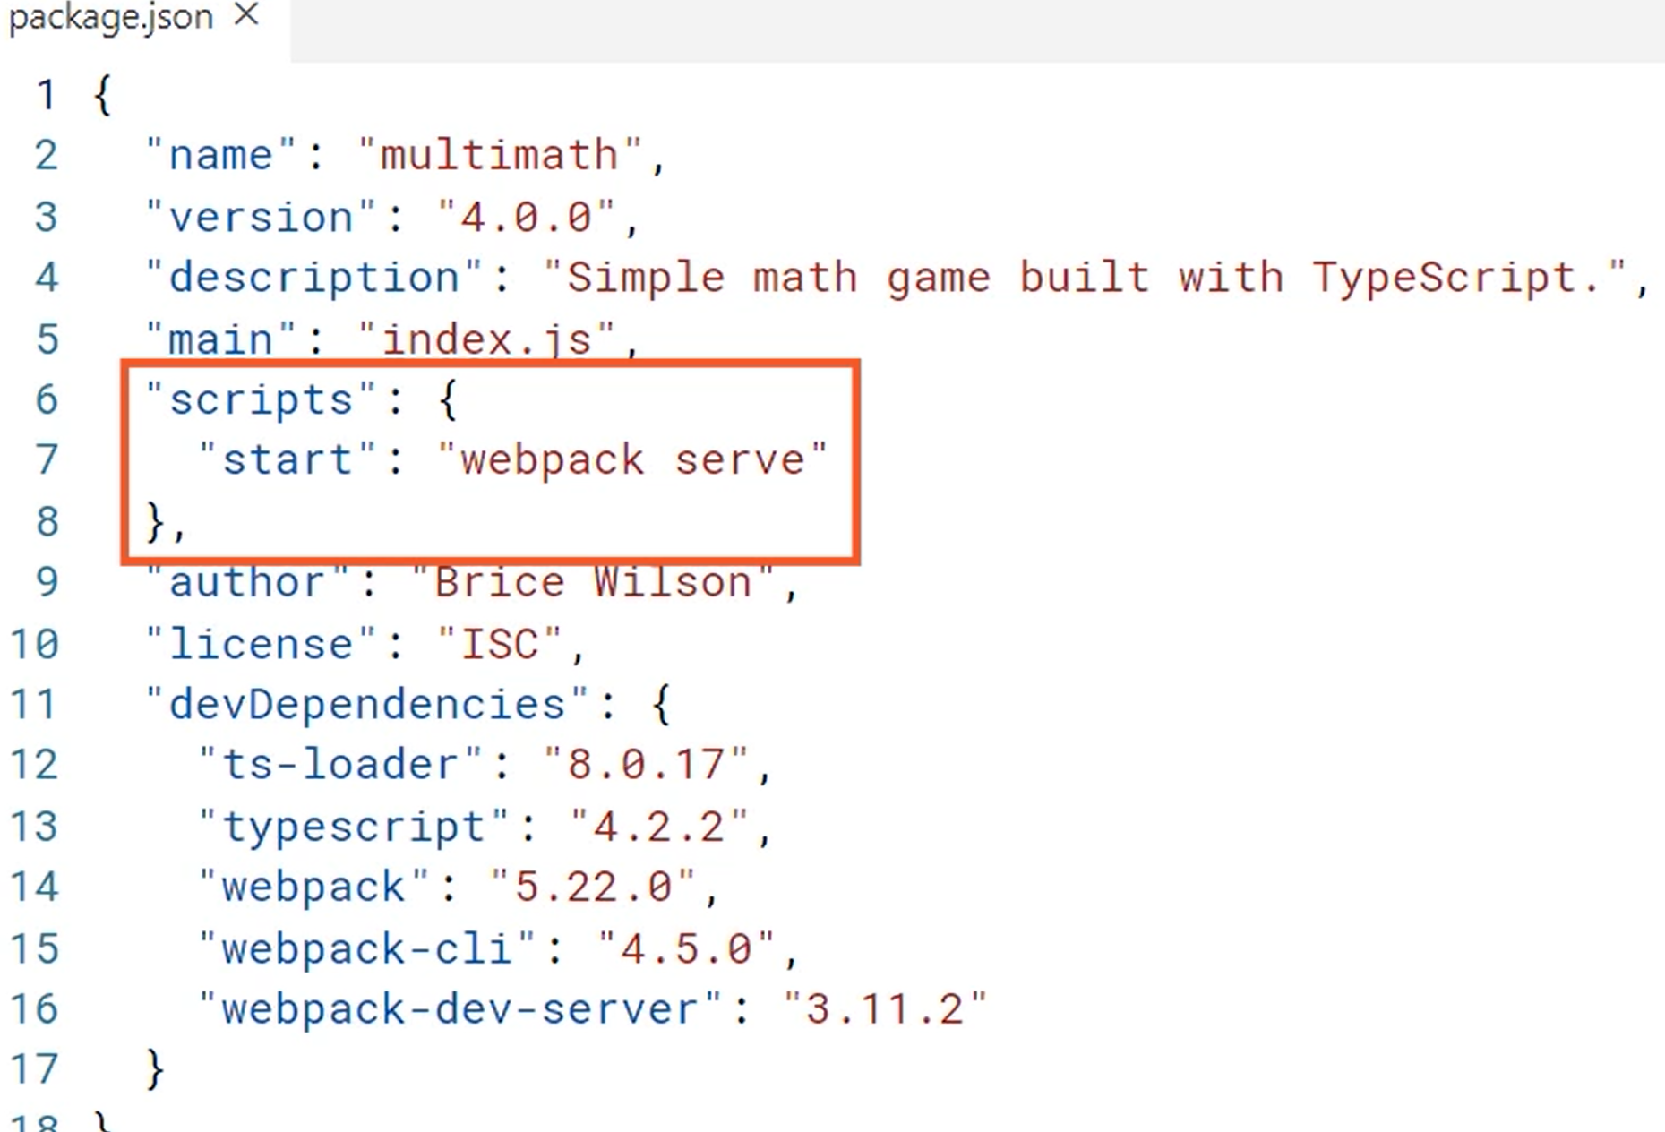
2
We can start the script with webpack serve command
We can use webpack to compile our code
When we have package.json we do npm install to include all the required packages
Notes:
Npm start ->starts the project

Slide 3
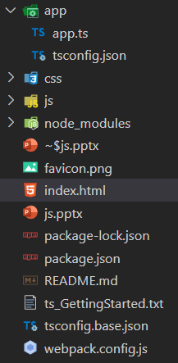
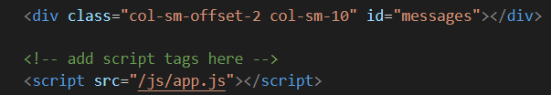
Working with config files
1. Make default compile options -> tsc --init ->this creared tsconfig.json
-> uncomment SourceMap:true ->this gives you possibility to debug ts
-> uncomment outDir -> "outDir": "js", ->tuj e dir-a det shte pishe compiliranite js fileove
-> in the end he added "watch": true ->tuj ostavia compilera running, za da moje avtoatichno da se kompilirat failovete
2. compile the js file from ts (ili direktno tsc samo) Ako watchera e pusnata niama nujda vseki put da kompilirame
tsc app.ts
3. then add the generated file in html file between the scripts tag
4. go again in the project root dir and npm start ->this will start the engine
5. adding inherited config files
-> rename the main config file to tsconfig.base.js
Tsconfig.json
{
"extends": "../tsconfig.base",
"compilerOptions": {
"removeComments": true
},
"include": [
"./**/*.ts"
]
}
in the include section we say in which dir da tursi za failove koit da kompilira
. -> start looking in the current dir
** -> tva znachi tursi rekursorvi vuv vsichki subdirs
*.ts -> tursi samo v ts failove
"include": ["./**/*.ts"]
Notes:
Config files are described in Project configuration
https://www.typescriptlang.org/docs/

Slide 4
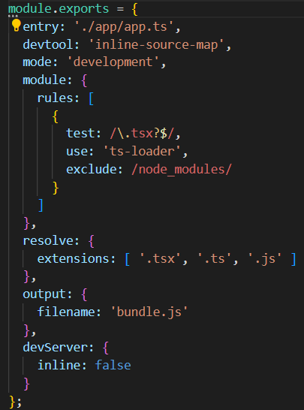
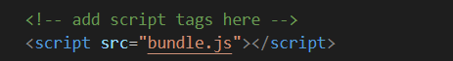
Using webpack for compiling
The config for that is stored in webback.config.js
Entry point for the app
Create me source map for the final bundle
Runs the typescript compiler for us
Which files to use for module resolution
Name of the bundle file webpack will produce
Keeps the browser from auto refresh when the new bundle is produced
Change the script file in html to point to the bundle
The bundle file is created only “in memory”, no real file is created

Slide 5
Union types – when we can assign different types
let playerName: number | null | undefined | string = 4;
Union type shotot moje da bude nay razlichni typove: number, null, string etc
Value assertions
let value: any = 5;
let fixedString: string = (value as number).toFixed(4);
Type annotations
function funFunc(score:string = “hello”, msg?: string): string { ->score has a default value, msg is optional parameter
return "hi";
}
Arrow functions
-> ako e null ili edin parametur i funkciata e na edin red niama nujda ot return statement
Let tst = x => x*x; ili let tst = () => console.log(hi)
Let res = Tst(2);
Ako sa dva + param i e na poveche ot 1 red ima nujjda ot skobi i return
let scores : number [] = [75,125,85,110];
let hsc : number [] ;
hsc = scores.filter( (el,index,array) => {
if(el > 100){
return true;
}
});
->returning void
let logger: (value:string) => void;
-sega mojem da si assignem kakvato I da e func det returnva void I priema string na logger
let logger: (value:string) => void;
if(score < 0){
logger = logError;
} else {
logger = logMsg;
}
logger(`${score}`);

Slide 6
Custom types
Interfaces
interface Employee {
name:string;
title: string;
}
interface Manager extends Employee {
department: string;
numOfEmployee: number;
scheduleMeeting: (topic: string) => void;
}
Duck typing -> if something walks like a duck, talks like a duck and swims like a duck then it is a duck
interface Employee {
name:string;
title: string;
}
let dev = {
name: 'Deni',
title: 'Dev',
editor: 'Visual studio code'
}
let newEmployee: Employee = dev; -> duck typing, shtoto dev objecta ima vsichki props na Employee interface-a
-interfaces doesn’t compile ->it doesn’t create .js files behind
Classes
interface Employee {
name:string;
title:string;
logID: () => string;
}
class Engineer implements Employee{
name:string;
title:string;
logID(){
return `${this.name}_${this.title}`;
}
}

Slide 7
Configure Project with multiple source files
V tsconfig.json add files array in the json and put all you files that need to be compiled
"files": [
"./app.ts",
"./person.ts",
"./player.ts",
"./result.ts"
]
//posle v ts file-a pishem key word ref i slagame referenciata kum faila det shte polzvame; tuj shte nakara compilara avtomatichno da kompilira i player.ts faila kato
kompilira faila v kojto e refnat. Tuj se naricha tripple slash directives
/// <reference path="player.ts" /> //ref provide reference za failovete /ref e ssushto i key word da ti generira ref-a
Primer v classa Player
/// <reference path="person.ts" /> class Player implements Person {
name: string;
age?:number;
hsc: number;
formatName(){
return this.name.toUpperCase();
}
}
In tsconfig file add also outFile ->this way we are telling to the compiler put all the compiled files in app.js
"compilerOptions": {
"removeComments": true,
"outFile":"../js/app.js"
},
Iztrivame vsichko ot js foldera, Posle startirme compilera otnovo ->tsc za da gi presuzdade
Ako rabotim s moduli vmesto outFile polzvame moduli i hich niama da ni triabva ref-direktivata (vij slide 12)

Slide 8
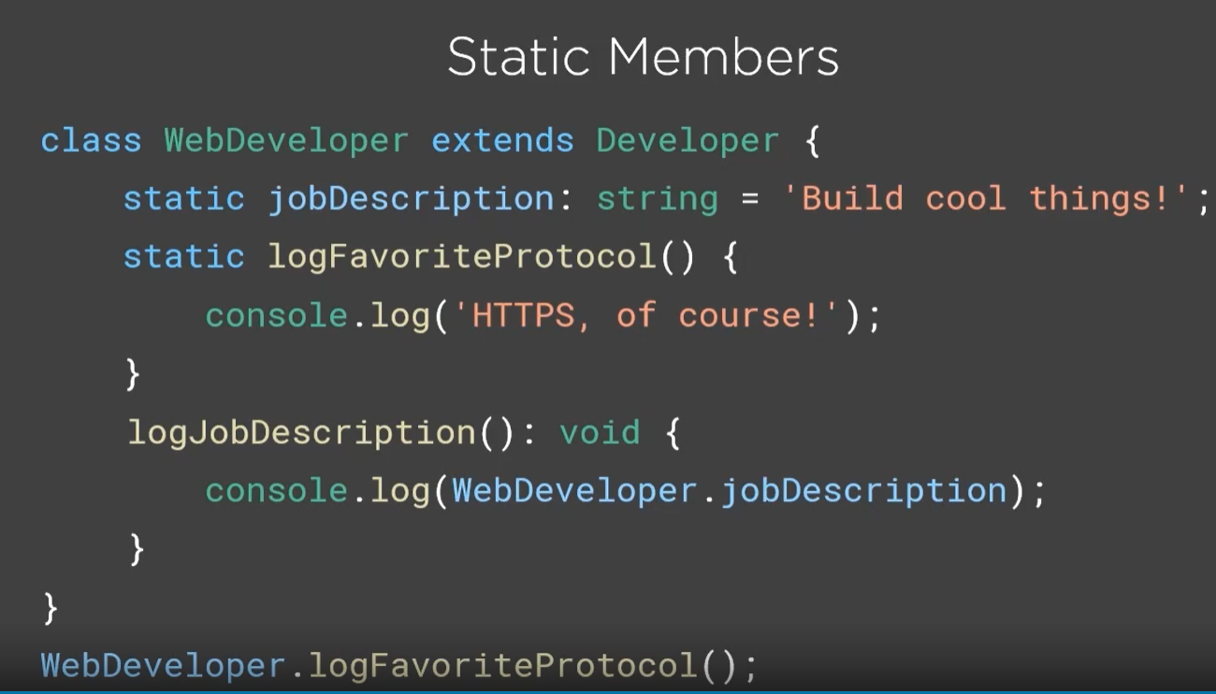
Static members & ctors

Slide 9
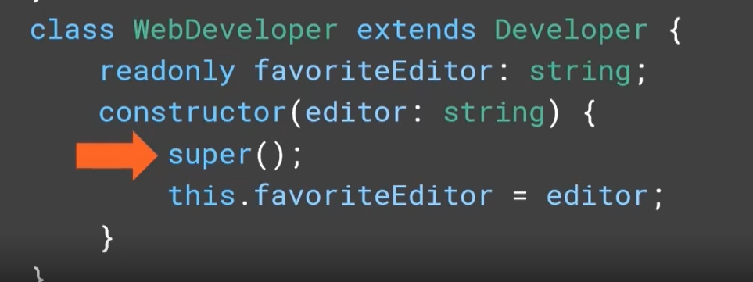
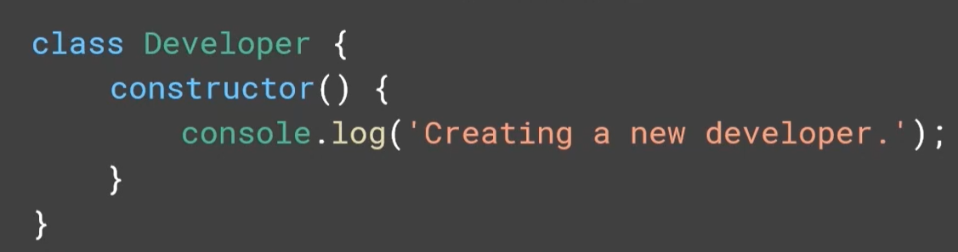
ctor
With super we call the parent ctor from the child class, Super e parent classa
//Ako niakude mi dade greshka type.. Is not assignable na type null slagame !
const scoresElement: HTMLElement = document.getElementById('scores')!;
Ako v ctora slojim na params det gi priema access modifier napr public, nima nujda da gi
deklarirame kato otdelni props i v klasa i da im kazvame this.player = player

Slide 10
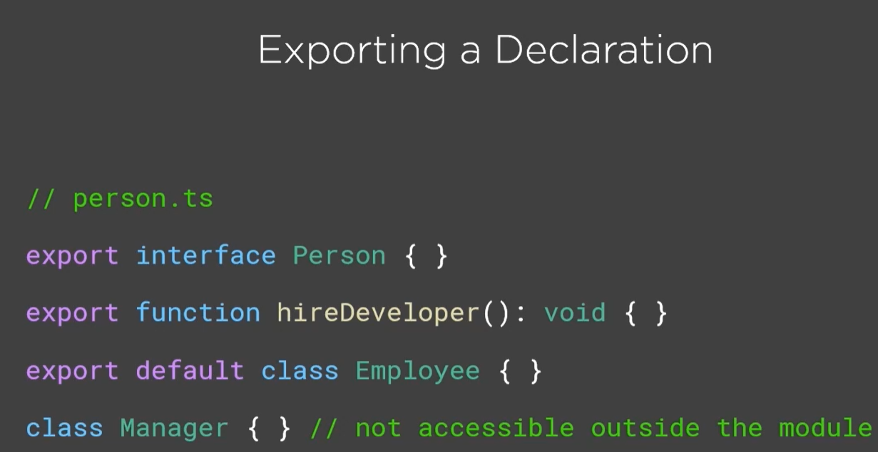
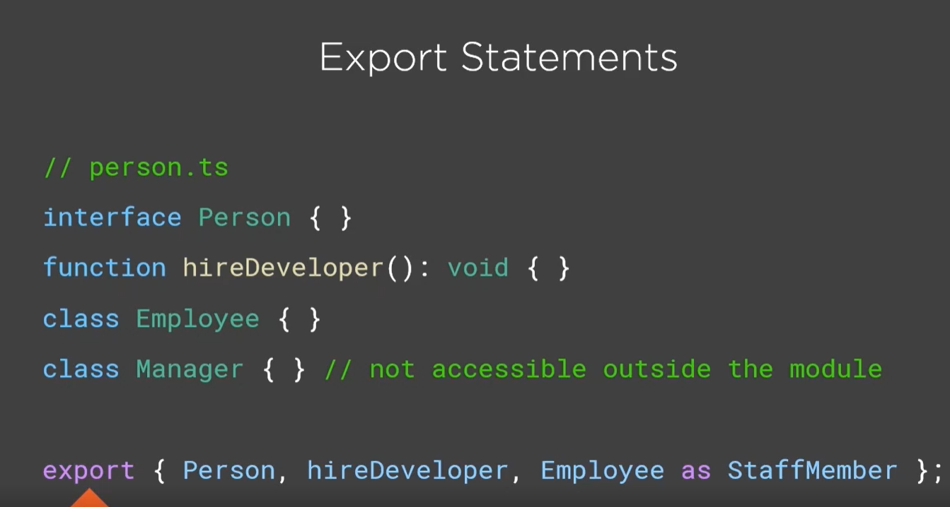
Modules – export/import
Default key word ->specify that this will be the default item exported for this module and if the import
module doesnt spceify which class to import it will be the default one
Export statements e sushtoto kato gornoto ama syntaksisa e drug -> naj otdolu prosto kazvame export …
Samo deto tuk ne mojem da polzvame default class, no puk mojem da polzvame as kato alias

Slide 11
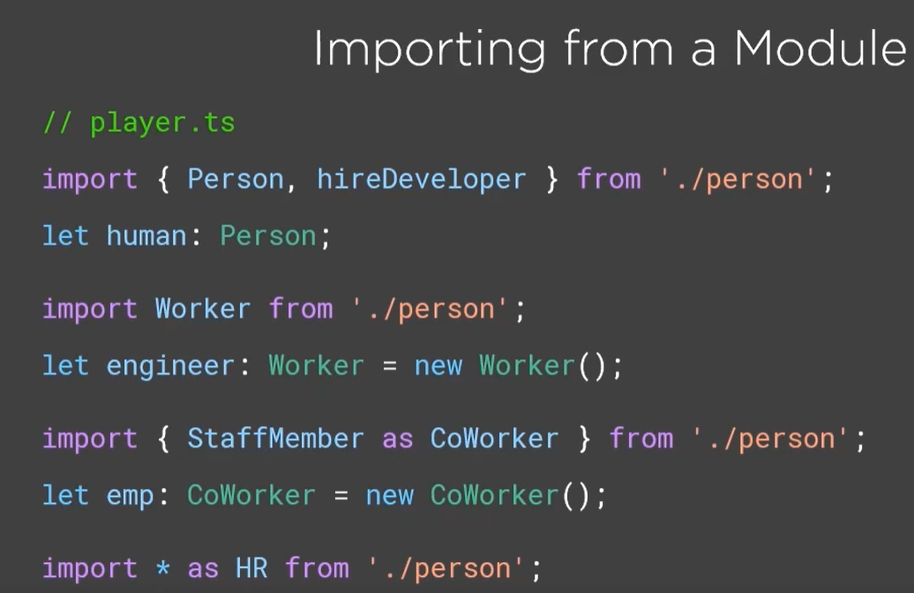
import
Import Worker ->nie prosto si go krushtavame taka Worker, inache tuj e
default classa, kojto e bul exportnat v person.ts e s drugo ime
Moje sushto chret as da im smenim imeto na klasa
- ako iskame da importnem vsichko polzvame *

Slide 12
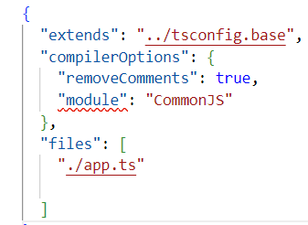
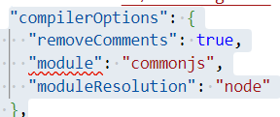
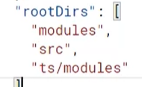
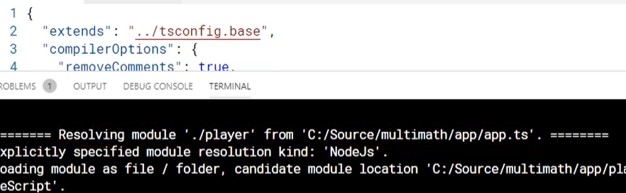
modules
Pri modulite niama nujda da rabotim s ref (/// <reference path=“person.ts" />
), prosto si importvam kakvoto ni e nujno. Niama nujda sushto da kazvame .ts
Pri importa shoto compilera avtomatichno si tursi v ts failover
// changing the names – using ALIAS
//importing all the module and using it as alias (changing its name)
import * as Helpers from './utility’;
//posle se polzva taka:
Helpers.getValue('playername');
import {ScoreBoard as ResultPanel} from './scoreboard’;
private scoreboard: ResultPanel = new ResultPanel(); //upotreba
import {Person} from './person';
import * as Helpers from './utility';
export class Player implements Person {
name: string;
age?:number;
hsc: number;
formatName(){
return this.name.toUpperCase();
}
}
V config file-a premahvame outFile v
compilerConfig (ako go ima) i slagame
modules
Relative vs not relative imports
Relatives ->they start with / ->pr './person’; ->polzvat se za modulate suzdadeni ot nas
Non relative does not include any reference to the directory structure -> import * as $ from 'jquery’; ->polzvate se kogato
polzvame 3rd party modules
Module resolution strategy ->classic and Node. Po-dobre da polzvame node. moduleResoultuion is obsional param in tsconfig,
tuj kato v zavisimost koj module sme slojili strategiata e izbrana avtomatichno. V sluchaja commonJs ^spada kum node.
Po-starite spadad kum classic.
Ako dobavim traceResolution:true v compilerOptions tuj shte ni dava info kak vseki module e resolvnat
Ako modulite sa ni razprusnati mojem da si dobavim rootDirs v compiler options i da mu kajem v koi papki da tursi
Notes:
/person ->root directory
./person -> go 1 dir up

Slide 13
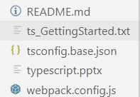
Configure module bundle - webpack
module.exports = {
entry: './app/app.ts',
devtool: 'inline-source-map',
mode: 'development',
module: {
rules: [
{
test: /\.tsx?$/,
use: 'ts-loader',
exclude: /node_modules/
}
]
},
resolve: {
extensions: [ '.tsx', '.ts', '.js' ]
},
output: {
filename: 'bundle.js'
},
devServer: {
inline: false
}
};
Webpack shte ni kompilira failovete do js.
Pravim si webpack.config.js fail
/v html si slagame ref kum bundle-a
<script src="bundle.js"></script>
Za da startirame projecta
npm start I otvariame na http://localhost:8080/

Slide 14
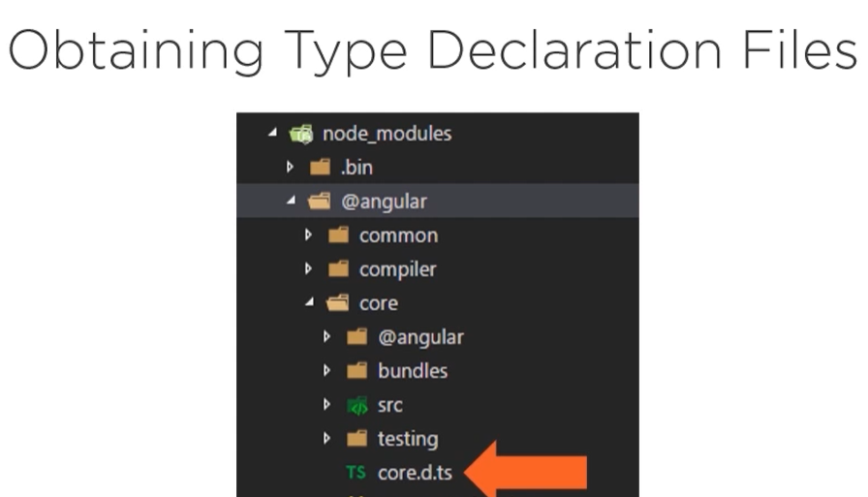
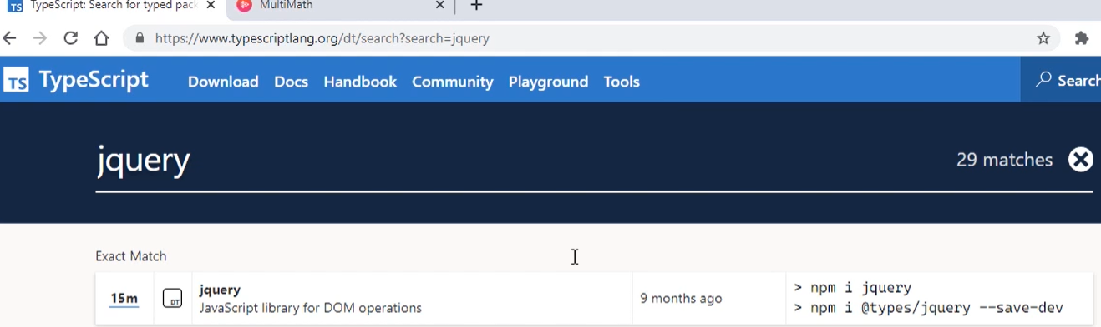
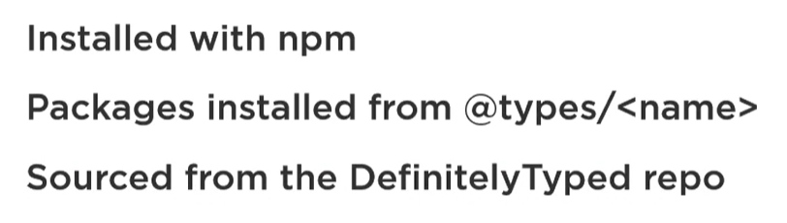
Type declaration files
Tova sa wrappers okolo js libraries. Imat edno name.d.ts v imeto. Mogat da se tursiat v typescript official site ->tools -> declaration files

